Slide 1
Use Case Diagrams
Comp3035
Systems Analysis and Design

Slide 2
Business Analysis (IBM definition)
The Use Case technique captures information about how a system or business currently works or should work.
“Although not a true object-oriented approach, the Use Case technique helps you build scenarios which model the processes of the system. It is an excellent way to lead into object-oriented analysis of systems”
Elementary business processes (EBPs)
It is the smallest task that can not be further broken down and hence is the basic unit of analysis.
EBP is initiated by event occurring at specific time and place
Discrete system response that adds business value

Slide 3
Use Case Diagrams
A Use Case represents an elementary business process (EBP) and how it would be carried out by the system.
A use case is made up of a set of scenarios.
Each scenario is a sequence of steps that encompass an interaction between a user and a system.
The use case brings scenarios together that accomplish a specific goal of the user.

Slide 4
Textual Description of a Use case
A use case can be specified by textually describing the steps required and any alternative actions at each step.
For example, the use case for searching a web for a keyword might be shown as:
Customer enters the keyword Customer clicks the search button The search is executed The results are shown
Alternative: Search Failed If the search fails at 3, then the user is redirected back to the search screen at step

Slide 5
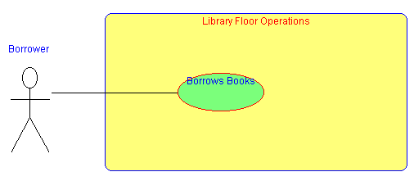
Use Case: Patron Loans a Library book

Slide 6
Elements of a Use Case Diagram
Actor An actor is a person, organization, or external system that plays a role in one or more interactions with your system. Actors are drawn as stick figures.
Use case A use case describes a sequence of actions that provide something of measurable value to an actor and is drawn as a horizontal ellipse.
Associations between actors and use cases are indicated in use case diagrams by solid lines. An association exists whenever an actor is involved with an interaction described by a use case. A use case can be carried out by many actors and an actor may carry out many use cases.
Associations are modeled as lines connecting use cases and actors to one another, with an optional arrowhead on one end of the line.
The arrowhead is often used to indicating the direction of the initial invocation of the relationship or to indicate the primary actor within the use case.

Slide 7
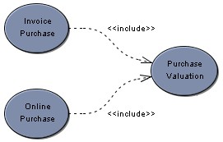
Association: Includes
Use cases can also be related to each other with three different types of associations or links.
Mandatory inclusion of another use-case
Both invoice purchase and online purchase include the scenarios defined by purchase valuation.
In general, the includes link is to avoid repetition of scenarios in multiple use cases
Functional Decomposition:
of a complex use case into simpler ones

Slide 8
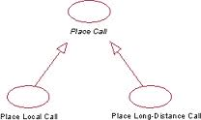
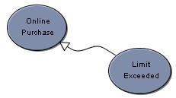
Association: Generalization
Allows Use Cases to support inheritance, When a use case describes a variation on another use case, use a generalization link.
In the example below, the use case limit exceeded describes a situation in which the usual scenario of online purchase is not performed.
Use cases that generalize another use case should only specify an alternative, even exceptional, scenario to the use case being generalized. The overall goal of the use cases should be the same.

Slide 9
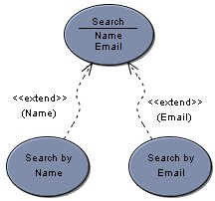
Association: Extends
Extension of the functionality of a use case to incorporate optional behavior.
A variation of behavior in a more controlled form.
In such instances you can define extension points in the extended use case.
search by name is said to extend search at the name extension point.
The extends link is more controlled than the generalization link in that functionality can only be added at the extension points

Slide 10
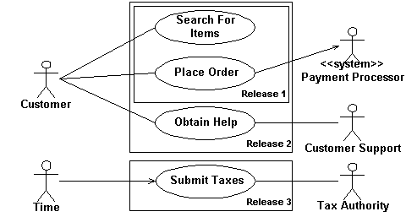
Use Case Diagram Optional elements: System Boundary
System boundary boxes (optional). You can draw a rectangle around the use cases, called the system boundary box, to indicates the scope of your system.
Anything within the box represents functionality that is in scope and anything outside the box is not. System boundary boxes are rarely used.

Slide 11
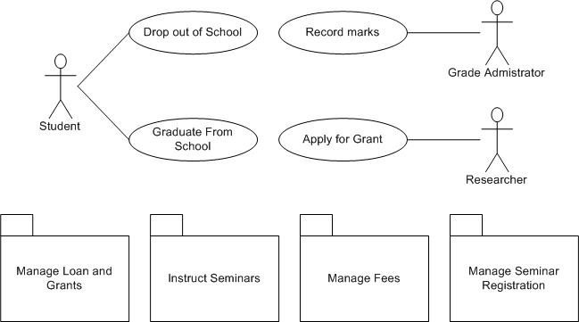
Use Case Diagram Optional elements- Packages
Packages: are UML constructs that enable you to organize model elements (such as use cases) into groups. Packages are depicted as file folders and can be used on any of the UML diagrams.

Slide 12
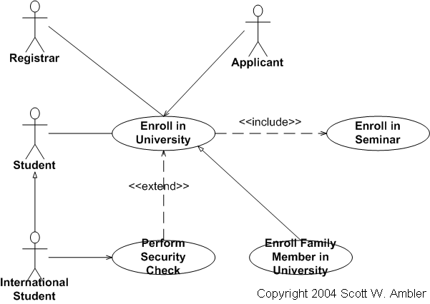
Example

Slide 13
